Slide 1
Gastrointestinal (GI) Dysmotility Diet Guideline Overview

Slide 2
Gastrointestinal (GI) Dysmotility Diet Guideline Overview
The goal of the GI dysmotility diet education is to assist consumers in choosing appropriate foods and fluids to maintain their nutritional status while minimizing unpleasant GI symptoms.
In general, calories come from carbohydrates, protein, and fat and are essential to your daily energy needs. Calories must equal or exceed calories expended for energy to prevent weight loss.

Slide 3
Gastrointestinal (GI) Dysmotility Diet Guideline Overview
Each meal consumed should be balanced and evenly distributed throughout the day (four to six meals) to maximize GI tolerance.
A balanced meal includes carbohydrate, high quality protein and fat.
The education provided in within this lecture was designed to educate you on every component of the recommended diet and will assist you in further translating the diet prescription into appropriate foods and the foods into appropriate meals.
At this time, let’s take a brief look at each component of the diet…

Slide 4
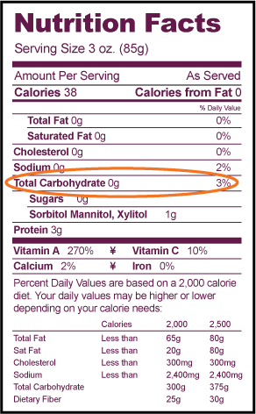
Dietary Carbohydrate
Dietary carbohydrates are the body’s main source of energy or fuel and therefore should comprise 40-60% of total calorie requirements each day.
There are two major types: Complex Carbohydrates and Simple Carbohydrates.

Slide 5
Carbohydrates: Complex and Simple
Complex Carbohydrates are also known as starches and fibers. Simple carbohydrates are also known as sugars.
Complex carbohydrates (starches) should be included in the diet and should make up the bulk of your daily calories. Examples of complex carbohydrates include: pasta, white rice, potatoes (without skins), bread, rolls, bagels, crackers, and pretzels.
Complex carbohydrates (fibers) should be avoided. Examples of fiber includes: whole wheat pasta, skin on potatoes, brown rice, whole wheat bread, whole wheat rolls, whole wheat bagels, raw fruits and vegetables with skins and/or seeds.
Simple carbohydrates (sugars) should be minimized. Examples of simple carbohydrates include: table sugar, jelly, jam, honey, regular syrup, candy, cake, cookies, ice cream, sherbet, smoothies and soda.

Slide 6
Avoiding Dietary Fiber
Why does fiber slow the movement of food throughout the GI tract?
Fibers can attract water and form a gel within the stomach and intestine which slows the movement of food throughout the GI tract.
Extensive research has demonstrated that patients on a high fiber diet experience more abdominal pain, discomfort, nausea and vomiting.
An overview of the fiber content within the food groups is outlined in the table:
FOOD GROUPS | FOODS TO AVOID | FOODS TO CHOOSE
Grains, cereal, pasta | Whole grains, brown rice, popcorn, potatoes with the skin, high fiber cereals, rye bread, whole wheat breads, corn bread. | White bread, white rice, crackers, refined grains, pretzels, refined cereals.
Fruits, vegetables and legumes | Skins, nuts and seeds of the plant. Avoid uncooked fruits or vegetables. Avoid corn, onion, lentils, peas and beans. | Cooked or canned fruits and vegetables with the skin removed. Casseroles. Sweet or white potatoes without the skin.
Milk and dairy products | Dairy products that are fortified with fiber. | Dairy should be consumed as tolerated as this is a naturally fiber free food.
Meats, fish, eggs and poultry | Tough cuts of meat, processed meats (hot dogs, sausage, cold-cuts) | Baked, broiled, tender meats/fish/poultry, tofu, ground meats, smooth peanut butter and any style eggs.

Slide 7
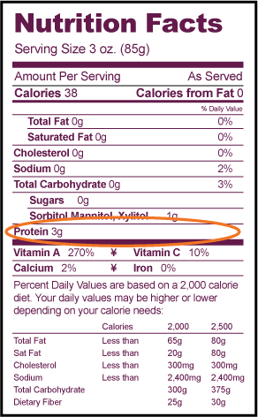
Dietary Protein
Protein has several essential functions:
Energy production
Growth and maintenance of tissue
Formation of essential hormones like insulin, estrogen, growth hormones
Development of enzymes such as lactase, lipase, sucrase
Antibody production
Regulation of body water and transport of nutrients

Slide 8
Dietary Protein
Protein should comprise 20-30% of total calories each day.
Not all proteins are alike; it is high quality protein from animal sources that is recommended at each meal and snack.
Examples of high quality proteins include: chicken, turkey, fish, pork, lean beef, and eggs.

Slide 9
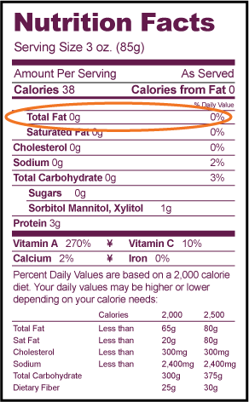
Dietary Fat
Fat is a very important part of the diet but not all fats are alike.
Foods high in animal fat and saturated fat should be limited.
Examples include: high fat meats, butter, shortening and whole milk. Instead, the low-fat forms of these products should be selected such as lean meats, margarine, low-fat milk and cheeses.

Slide 10
Dietary Fat
Essential fats or essential fatty acids (EFA’s) should be the focus since it is the EFA’s that the body cannot make on its own. EFA’s are found in polyunsaturated fats.
Examples include: soybean, safflower, and sunflower oil as well as products made with these oils such as regular mayonnaise, soft tub margarine, and regular (non-creamy) salad dressings.
Fat can be difficult to tolerate as it tends to move the slowest throughout the gastrointestinal tract.
A low-fat diet is recommended in some cases of extreme gastroparesis and intestinal dysmotility.
The recommended intake for those able to tolerate fat is about 30% of total calories.

Slide 11
Dietary Fat
Including liquid fats, like oils, or small amounts of fat at each meal are ways to increase fat intake while minimizing discomfort.
Extensive research has demonstrated that patients on a high fat diet experience more abdominal pain, discomfort, nausea and vomiting.
An overview of the fat content within the food groups is outlined in the table:
FOOD GROUPS | FOODS TO AVOID | FOODS TO CHOOSE
Grains, cereal, pasta | Crackers, chips, fried breading. | White bread, white rice, crackers, refined grains, pretzels, refined cereals.
Fruits, vegetables and legumes | Fruits, vegetables or legumes that are fried or cooked with excessive oil/butter | Cooked or canned fruits and vegetables with the skin removed. Sweet or white potatoes without the skin.
Milk and dairy products | 2% or whole dairy products (milk, yogurt, cheese). | If tolerated, skim or 1% dairy products (milk, yogurt, cheese).
Meats, fish, eggs and poultry | High fat beef/pork/lamb. Avoid meats with visible fat (white-marbling) | Egg whites, skinless chicken or turkey breast, lean pork/beef/lamb/veal, liver, fish, shrimp, and crab.

Slide 12
Fluid
Appropriate oral fluids are important to allow for the best intestinal absorption. With improved fluid absorption, dehydration can be avoided and IV hydration can be minimized. Oral rehydration solutions allow for the best intestinal absorption. The type and quantity of oral fluid that is needed will be determined based on your bowel anatomy and the volume of stool and urinary output. Hydration will be explored in great detail in the next module.

Slide 13
Diet Tips to Remember
Small, frequent meals are the easiest to tolerate. Try ¼ to ½ c of a given food at a time and monitor your response.
Continue to add new foods to your diet. It is ok to re-try foods that you were unable to tolerate previously. Sometimes trying a smaller amount at a later time will allow you to increase the variety of foods in your diet.
Chew your food well. This is the first step in digestion and can make a huge difference in GI tolerance.
Liquids tend to be easier to tolerate and can improve total caloric intake. If your fullness increases as the day progresses, try switching over to liquid beverages that contain calories (shakes, juice, milk, etc.).
Don’t lie down after a meal. Try to sit up or walk around to help the food move throughout your GI tract.

Slide 14
Case Study – Putting a Meal Together
AC is a 37-year-old male with newly diagnosed intestinal dysmotility. His main complaints are crampy, abdominal pain especially after dining out. AC becomes frustrated when grocery shopping since starting to make his own meals. AC knows from his nutrition support team, that he needs to make carbohydrate, fat and protein a part of each meal. Some of AC’s favorite foods are cereals, fruits, hamburgers, French fries and sandwiches.
Notes:
19309031

Slide 15
Case Study – Selecting the Right Foods
Breakfast:
1c. Corn flakes
½ c. 1% milk
½ c. Canned peaches in own juice
1 Hard boiled egg
¾ c. Juice (any variety)
Snack:
1 Tbsp. Peanut butter
2 Rice cakes
Dinner:
1 Hamburger, grilled (98% lean ground beef)
1 Slice low-fat American cheese
1 White bun
3 ounces Baked French fries, skinless
1c. Well-cooked carrots
Carbohydrate
high quality protein
fat
Snack:
1 ounce Lunchmeat
1 Low-fat mozzarella cheese stick
6 Low-fiber, low-fat crackers (<2g fiber per serving, <3g fat per serving)
Lunch:
1c. Tuna fish packed in water mixed with 1Tbsp mayonnaise, salt and pepper
1 Slice white pita bread
1 Banana
1c. Pretzels

Slide 16
Thank you!

