Slide 1


Welcome to the
MitoAction Monthly Expert Series
Understanding the new Recommendations of the Safety of
Drug Use in Patients with Primary Mitochondrial Disease
Presented by: Dr. Amel Karaa

Slide 2


What is the list?
This is a list of medicines (drugs) that should be avoided or used with caution in people affected by a primary mitochondrial disease.
Patients suspected of having a primary mitochondrial disease, but in whom the diagnosis has not yet been confirmed by doctors, may also consult this list.
Understanding the New Recommendations of the Safety of
Drug Use in Patients with Primary Mitochondrial Disease
Dr. Amel Karaa
Notes:
http://pixabay.com/en/ipad-macbook-tablet-computer-606764/

Slide 3
WHY DID THE LIST OF DRUGS TO BE AVOIDED NEED UPDATING?
We saw that the existing list of medicines thought to be unsuitable (contraindicated) in patients with mitochondrial disease was very long and contained drugs that we felt could be useful in treating patients with mitochondrial disease.
Therefore, we thought it was important that each medicine on the list was reviewed and updated with the latest clinical and scientific evidence.
Understanding the New Recommendations of the Safety of
Drug Use in Patients with Primary Mitochondrial Disease
Dr. Amel Karaa
Notes:
http://pixabay.com/en/ipad-macbook-tablet-computer-606764/

Slide 4
WHAT WAS THE PROCESS BY WHICH THE LIST WAS REVIEWED AND UPDATED?
Understanding the New Recommendations of the Safety of
Drug Use in Patients with Primary Mitochondrial Disease
Dr. Amel Karaa
Notes:
http://pixabay.com/en/ipad-macbook-taOur group consisted of sixteen doctors, pharmacists and scientists and each was assigned a group of drugs to evaluate.
These experts then spent 2 months researching the evidence for whether the medicine was harmful for mitochondrial disease patients for each of the drugs assigned to them.
The group then met for a two day workshop to discuss the evidence for > 50 drugs and decide whether or not they could safely be used in mitochondrial disease. This process of evaluating evidence is known as a Delphi workshop, and is widely accepted as a valid scientific method.
blet-computer-606764/

Slide 5
WHAT WERE THE CONCLUSIONS OF THE WORKSHOP?
After a thorough review of the evidence, we concluded that most drugs on previous lists could be used safely in people affected by primary mitochondrial disease.
Understanding the New Recommendations of the Safety of
Drug Use in Patients with Primary Mitochondrial Disease
Dr. Amel Karaa
Notes:
http://pixabay.com/en/ipad-macbook-tablet-computer-606764/

Slide 6
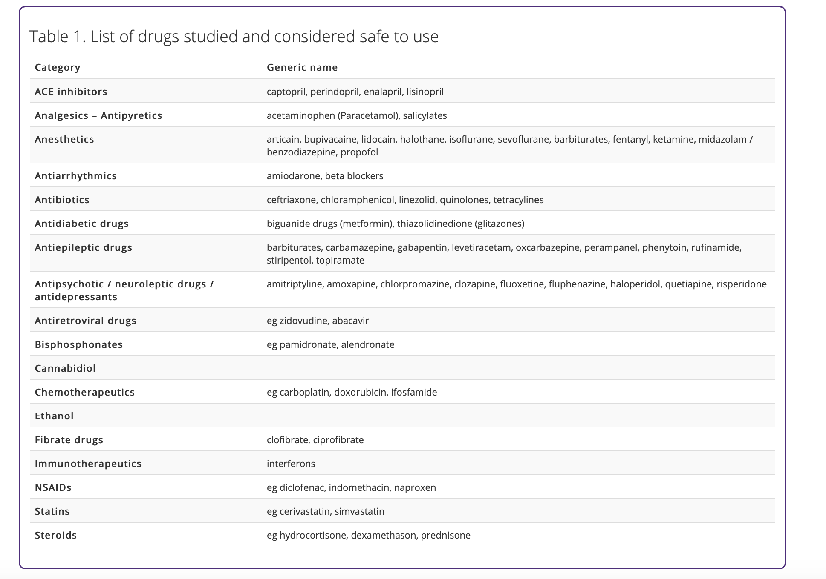

Slide 7
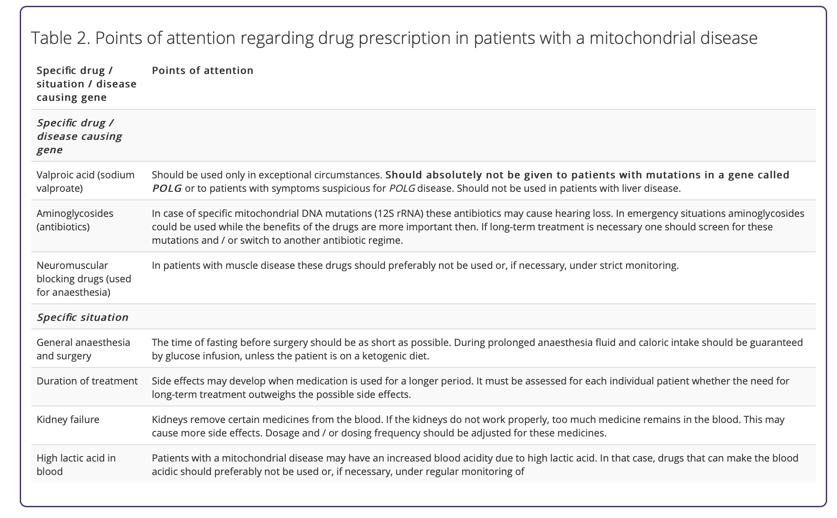

Slide 9
Understanding the New Recommendations of the Safety of
Drug Use in Patients with Primary Mitochondrial Disease
Dr. Amel Karaa
It is important to remember that side effects can occur with any medicine in any patient.
This can affect anyone taking the medicine and may not be related to your mitochondrial disease.
It is therefore essential that you take the advice of your doctor and read the information given with the medicine.
Notes:
http://pixabay.com/en/ipad-macbook-tablet-computer-606764/

Slide 10
WHY IS THIS LIST NOT THE SAME AS OTHER LISTS OF MEDICINES TO BE AVOIDED IN MITOCHONDRIAL DISEASES?
This is a NEW UPDATED VERSION to replace all previous lists of medicines to be avoided in primary mitochondrial disease, based on the latest scientific and clinical evidence.
Understanding the New Recommendations of the Safety of
Drug Use in Patients with Primary Mitochondrial Disease
Dr. Amel Karaa
Notes:
http://pixabay.com/en/ipad-macbook-tablet-computer-606764/

Slide 11
WHAT SHOULD I DO WITH THE LIST?
It is very important that you consult your doctor whenever you are unwell. You may, however, wish to share the "List of medicines considered safe to use" and the "List with points of attention" with your doctor(s) and discuss with them what this means for you and your particular type of mitochondrial disease.
Understanding the New Recommendations of the Safety of
Drug Use in Patients with Primary Mitochondrial Disease
Dr. Amel Karaa
Notes:
http://pixabay.com/en/ipad-macbook-tablet-computer-606764/

Slide 12
Thank you,
Questions?
Understanding the New Recommendations of the Safety of
Drug Use in Patients with Primary Mitochondrial Disease
Dr. Amel Karaa
Notes:
http://pixabay.com/en/ipad-macbook-tablet-computer-606764/

