Slide 1
IEP Considerations for Students with Mitochondrial Disorders
Gena Padgett, School Psychologist
August 7, 2020
Notes:
Introduction of Self
Dealing with school issues but also during a pandemic

Slide 2
Presentation Overview
How can families/guardians become empowered?
What are educational needs?
Determining the type of school plan to meet a student’s needs
Meeting student needs: services and/or accommodations
Understanding accommodations and services
Additional school plan factors

Slide 3
Navigating School Plan Development
Procedural Safeguards
Provides an explanation to families and guardians of special education procedures for a given state so they can become acquainted with terminology and be informed of what to expect and is required of a school system
Lists available agencies to provide advocacy support by serving as a reference for school processes and strengthening family and school relationships
Notes:
MitoAction has resources
State laws and listing of advocates, free and paid
Role of an advocate – knowledgeable for special education law and school procedures, empower you what to expect within a meeting, review with you ahead of time drafts of paperwork and give suggestions that are appropriate, attend meetings with you, promote positive interaction between schools and families

Slide 4
Examples of Potential Educational Needs
Academics | Developmental | Biological
Reading | Self-Care | Sensory
Writing | Physical Skills | Neurological
Mathematics | Communication | Digestion
Spelling | Learning | Excretory
Study Skills | Social-Emotional | Respiratory
 |  | Circulatory
Notes:
More than just academics but how other areas can affect school performance

Slide 5
School Planning: Individualized Education Program (IEP) or Section 504?
Not which one is better but rather which one will best meet needs
Both are legal documents that must be implemented after being created

Slide 6
Type of Law
Special Education Individuals with Disabilities Act (IDEA)
Department of Education
Civil Rights Rehabilitation Act of 1973
Office of Civil Rights
Requirements for Eligibility
Has a disability that meets IDEA criteria that affects educational performance and requires specialized services
Has a health condition that affects school functioning
What is typically included
Through 12th grade or until age 21 while attending public school
No age limit; used for any government institution: work, school, college, etc.
Age Limit
Specialized education services, accommodations, related services
General education accommodations and related services for equal access

Slide 7
How To Meet Needs
Services to Strengthen Skill Needs
Goals and Objectives that will be Targeted
Frequency of Services
Accommodations to Promote Equal Access
Used for Daily Performance and State Tests

Slide 8
Accommodations
Accommodations are changes that remove barriers to learning.
Accommodations change how kids learn.
Modification changes what your child is expected to know or learn.
8

Slide 9
Types of Accommodations
Presentation: Change in the way information is presented
Setting: Change in environment
Timing and Scheduling: Change in time a student has for a task
Response: Change in way student completes school tasks
9
Notes:
Example of Presentation: Provided with teacher notes
Response: Word Processing, Scribe
Setting: Resource room to be taught supplemental reading curriculum: in general education room as possible
Timing/Scheduling: Additional time, rest breaks

Slide 10
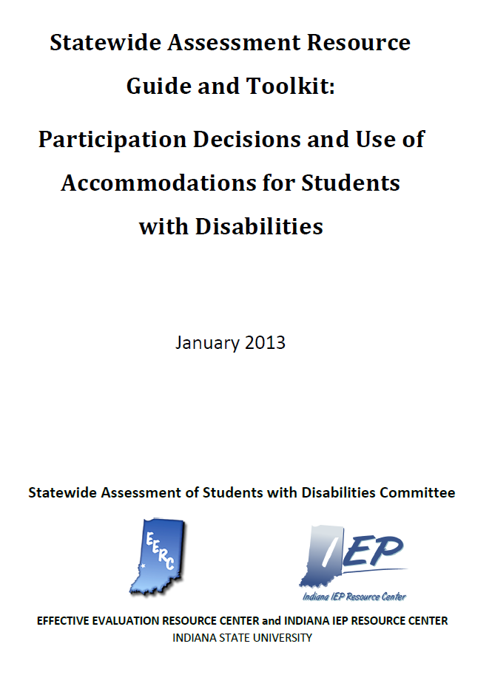
Examples of Accommodations
10
Notes:
Examples listed on the MitoAction Web Site
Dyslexia – writing and math technology use
Each state listing of what is accepted accommodations for State tests

Slide 11
Factors to Consider When Determining Accommodations
Prioritize: What are the most important things everyone working with your child should know so that there are successful outcomes?
Implementation: What can be implemented by everyone working with your child so that there are successful outcomes across settings?
Responsiveness: What accommodations will your child successfully utilize to promote independence?
11

Slide 12
Services
What skills need to be taught by an educators or related services professionals so that your child’s educational needs are met?
When and where will these skills be taught?
12
Notes:
Goals that the provider will work on, when, and where
Appropriate amount of support: one-on-one aide: learned helplessness, authoritarian

Slide 13
Progress Reports
Quarterly updates on how your child is progressing in targeted goals listed within a special education plan
While school or family/guardian can request a meeting at any time, school plans are revisited and updated annually

Slide 14
Other Plan Considerations
IEP Transition Planning: Adult independent functioning
IEP Extended School Year: Data show skill regression; critical period in development
Health Plan: Procedure school will follow to meet health needs
14

Slide 15
eLearning Resources
Discussions with Teachers of Available School Programs
Online Examples: Mindplay, Dreambox, Kahn Academy, IXL, ABC Mouse
Reading Rockets , What Works Clearinghouse
vRoom for promoting early childhood development
15

