Slide 1
The ins and outs of CHOP Mito Clinic
MitoAction Expert Series Meeting
August 5, 2022
Amy Goldstein, MD
Jamie Peterson, MS, LCGC

Slide 2
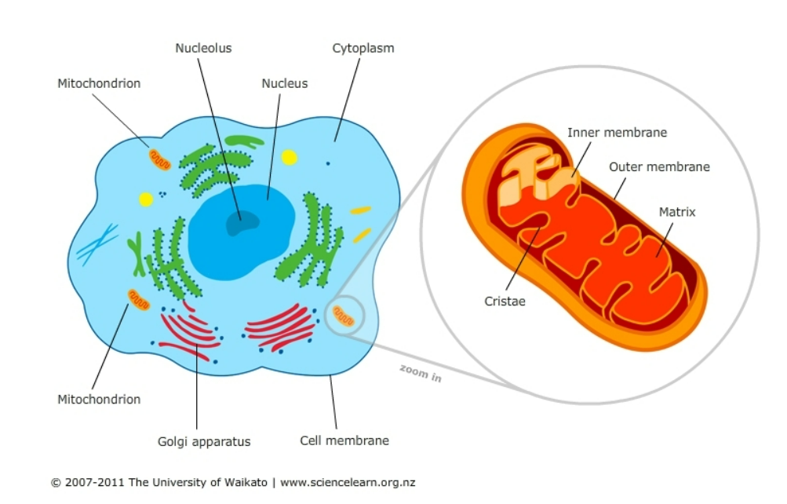
What is mitochondrial disease?
Mitochondrial are our bodies’ “batteries”
Primary mitochondrial disease is an “energy deficiency” due to a mutation(s) in the DNA that affect the mitochondria

Slide 3
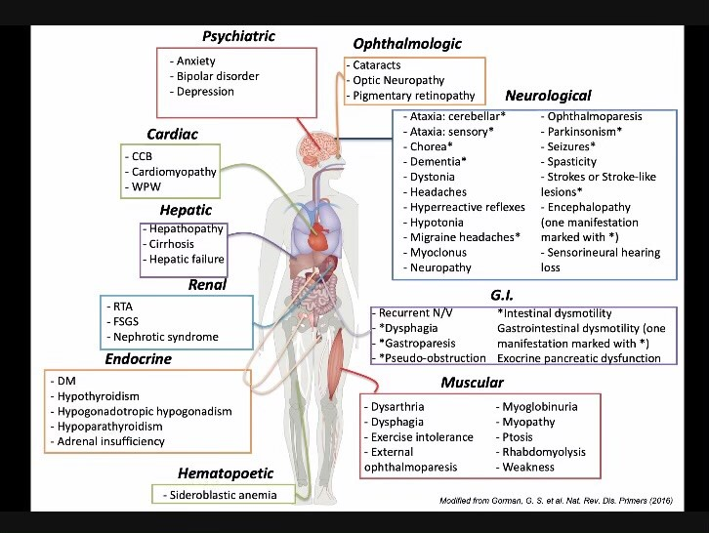
What does mitochondrial disease look like?
Mitochondrial Disease can cause a wide variety of symptoms in “high energy organs”
Generally, 3 or more organ systems involved
Onset of symptoms can range from infancy to adulthood

Slide 4
How to be referred for evaluation
Discuss your symptoms with your PCP or one of your other doctors
Ask if a referral for a mitochondrial disease work-up is appropriate
Have your doctor send a referral to our team
Referrals may be sent to:
MMFP@chop.edu
Fax 215-590-0582
Please use subject header: “New patient referral”

Slide 5
Referral review
All referrals are reviewed to see if the patient is an appropriate fit for a mitochondrial disease work-up
Complete records are crucial for an expedient review
Incomplete records take more time to review
Records checklist (not comprehensive)
Referral from your provider stating why you were referred
All genetic testing records, if performed
Records from specialists for your corresponding symptoms
Laboratory studies
Brain MRI images, if performed
Previous muscle or skin biopsies records, if performed

Slide 6
Referral Review
Please feel free to check in on the status of your referral!
The best way to contact our clinic as a new patient is by email
MMFP@chop.edu
For current patients, the MyCHOP messaging system is the preferred method
Phone: 267-426-4961

Slide 7
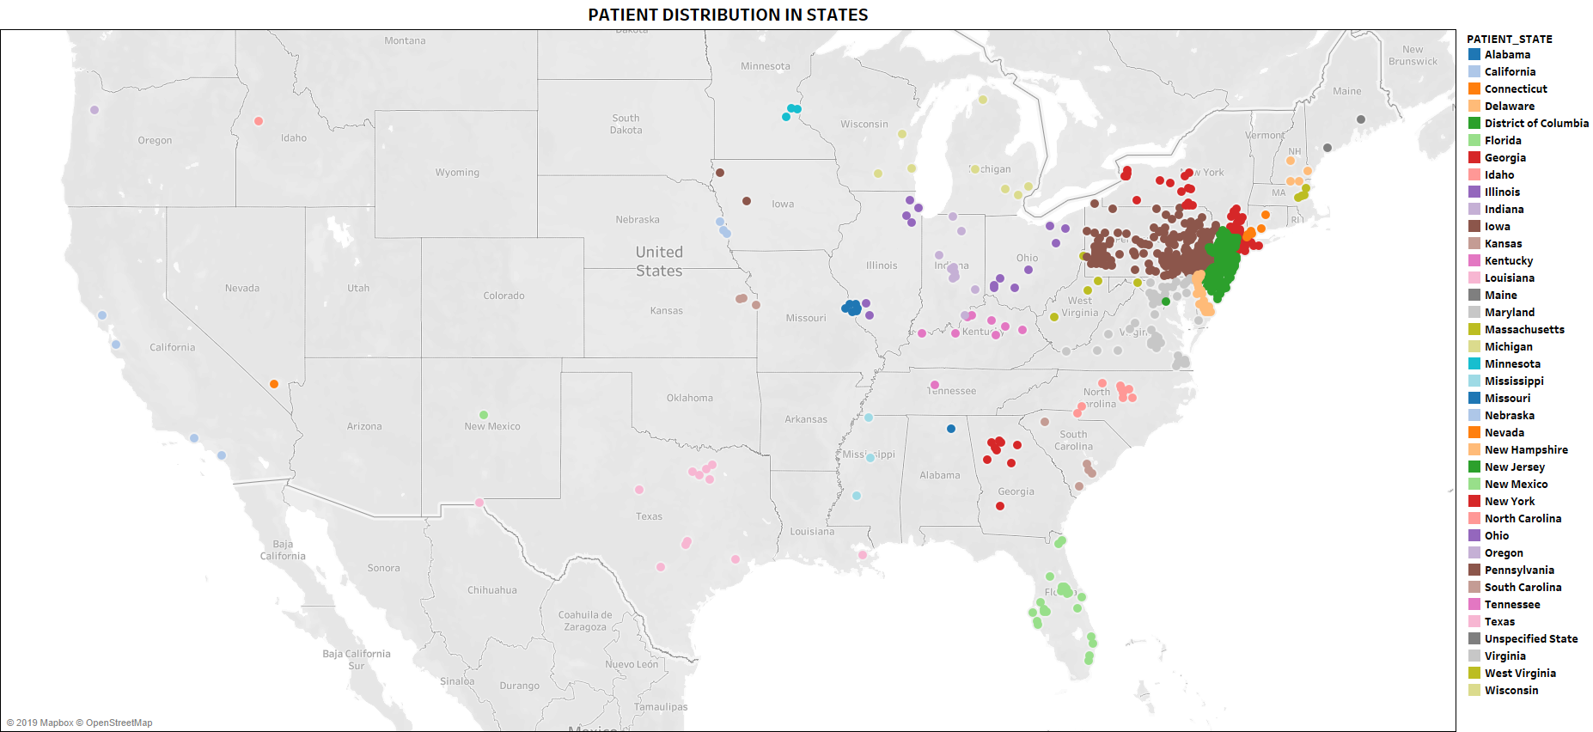
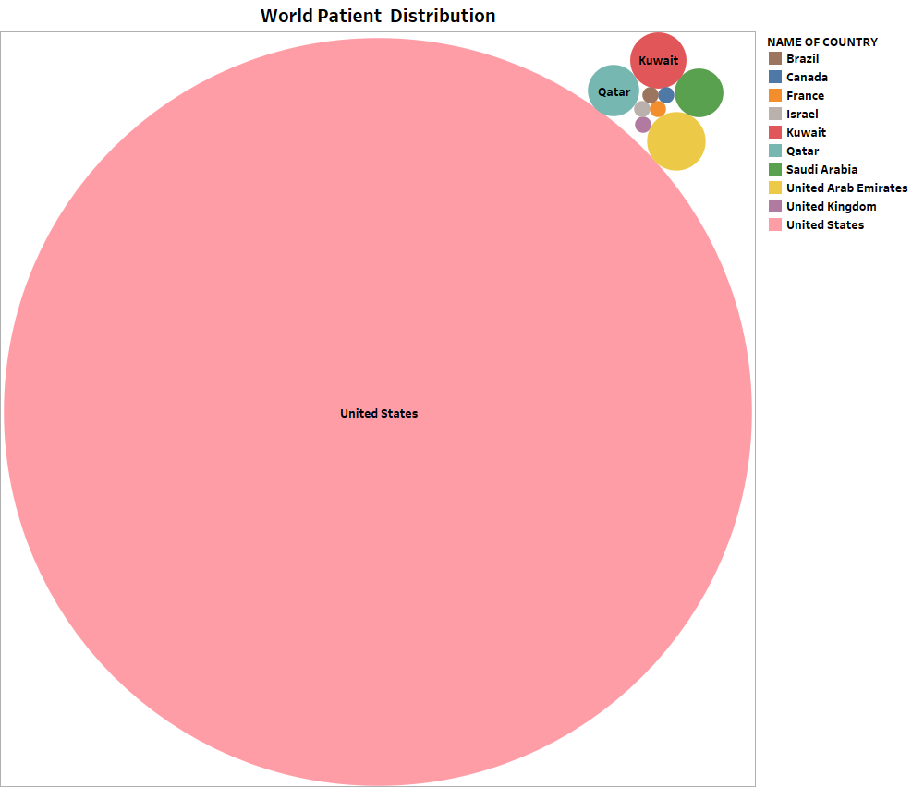
MMFP: Global patient distribution
MMFP-Tableau
Ibrahim George-Sankoh

Slide 8
Difficulty getting to CHOP?

Slide 9
What does CHOP Mito Team Provide?
Care coordination for patients with primary mitochondrial disease
Genetic testing is needed to confirm the diagnosis
Diagnostic Testing for undiagnosed patients with a clinical suspicion for mitochondrial disease
Clinical trial site for patients with a confirmed primary mitochondrial disease
Research studies aimed at improving the diagnosis rate of mitochondrial disease and exploring potential future therapeutic options for mitochondrial disease

Slide 10
More information about CHOP Mito
https://www.chop.edu/centers-programs/mitochondrial-disease-clinical-center
https://www.facebook.com/Mitocenter/
https://www.facebook.com/chopmitochondrialmedicinecenter

Slide 11
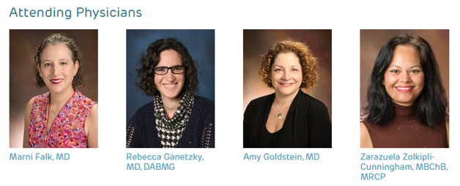
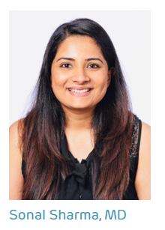
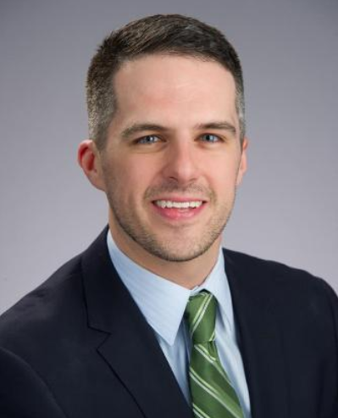
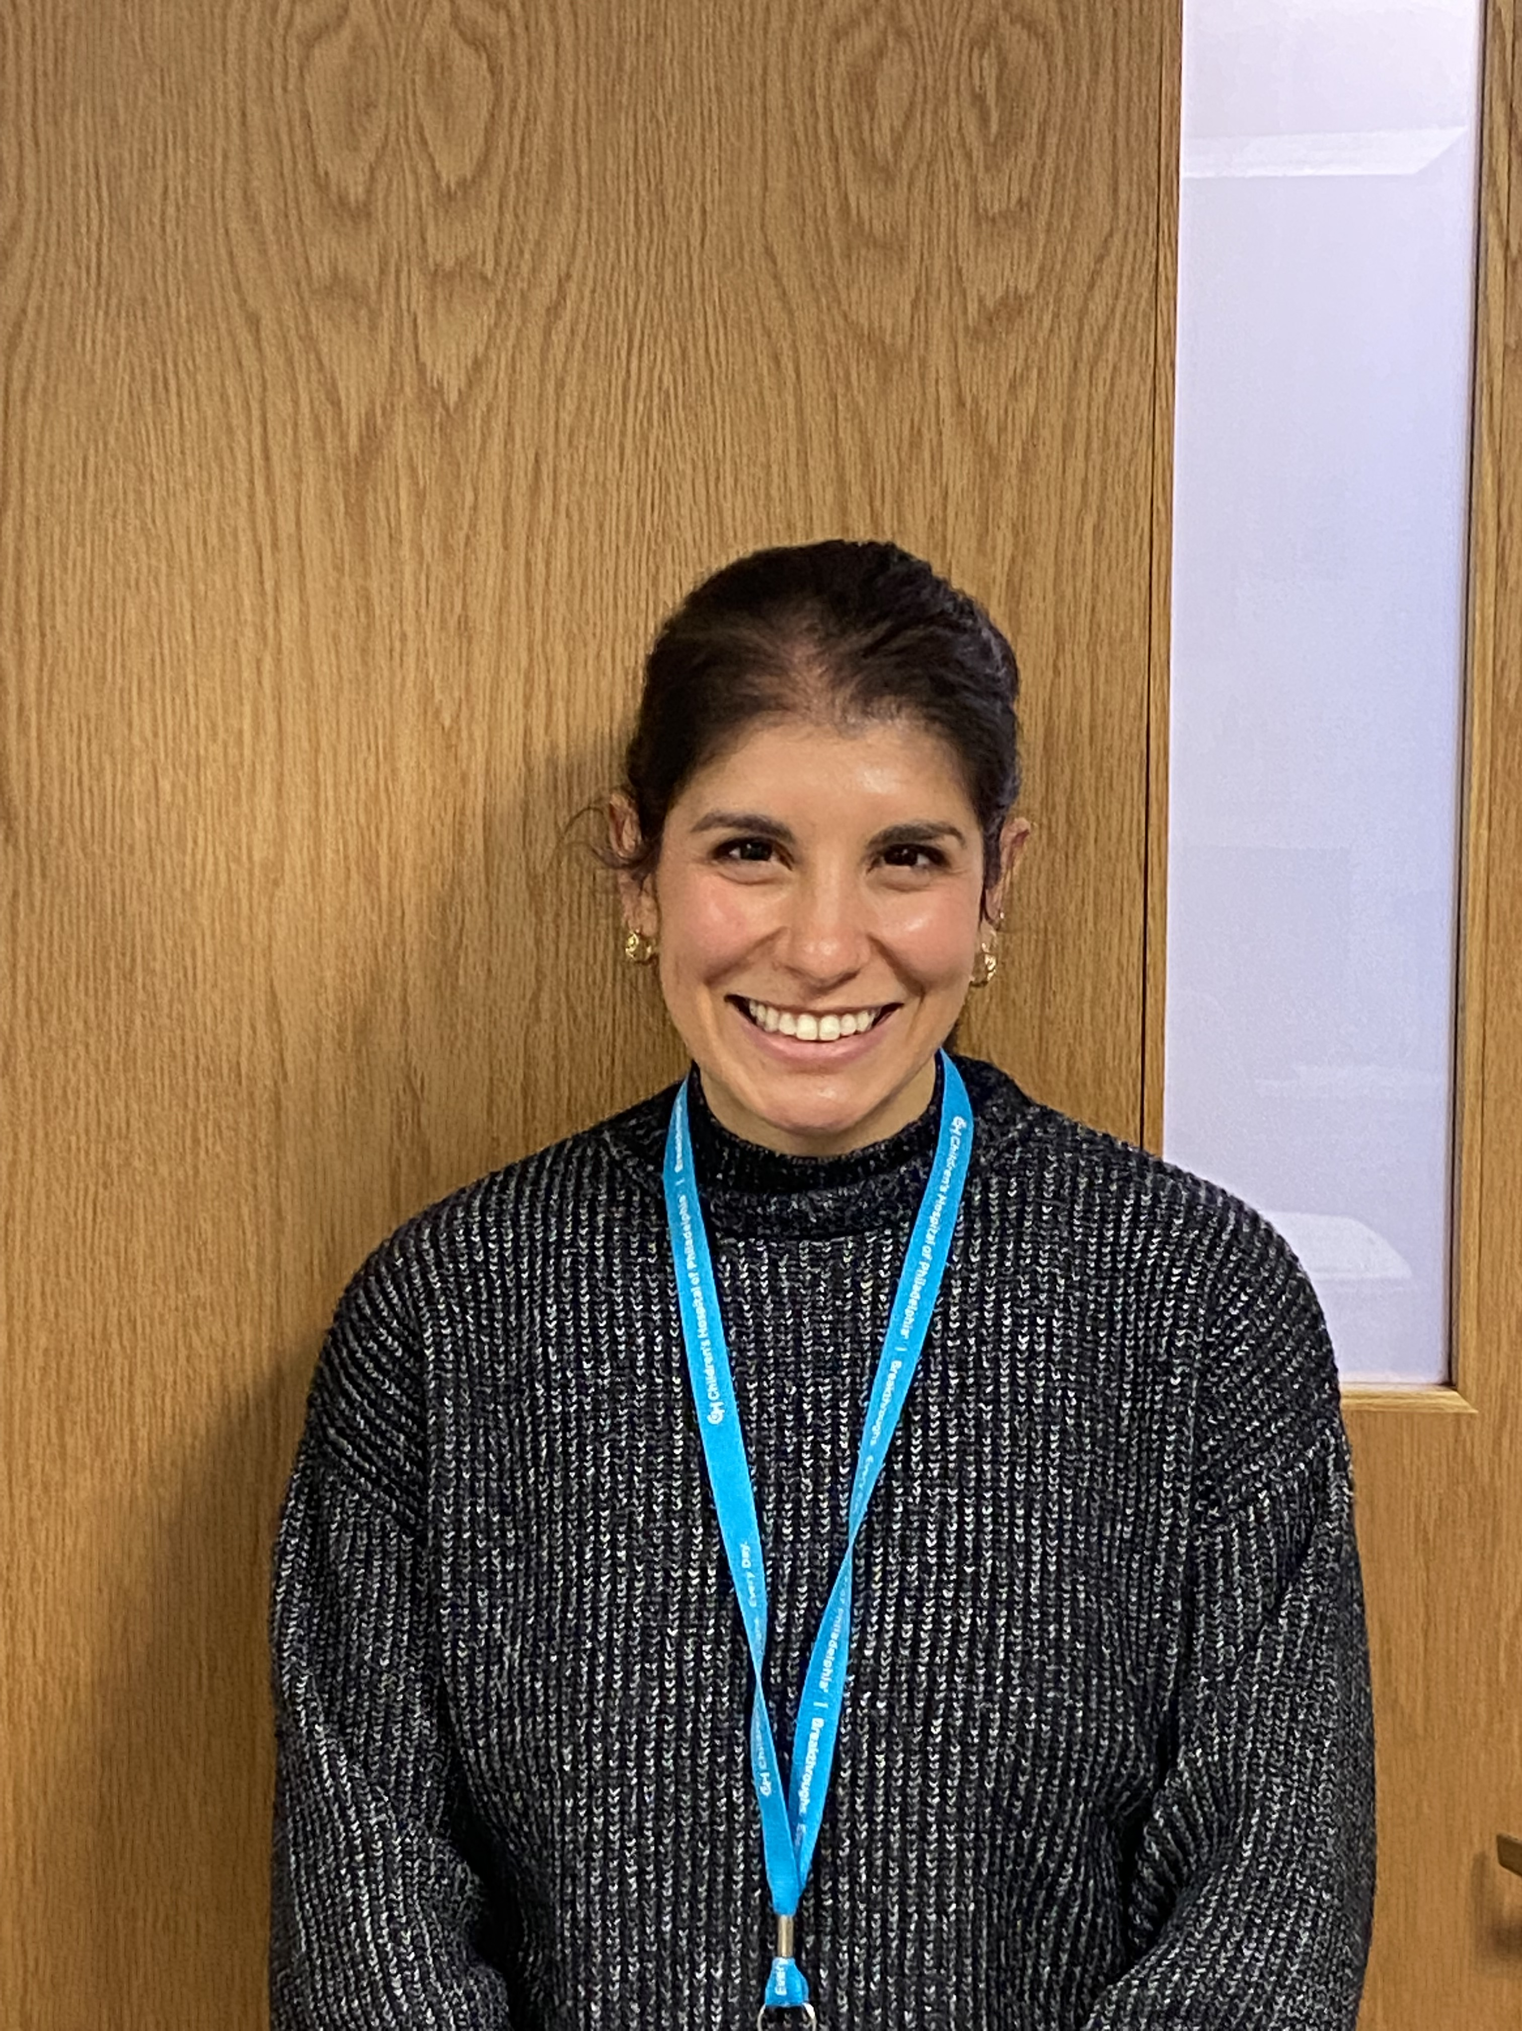
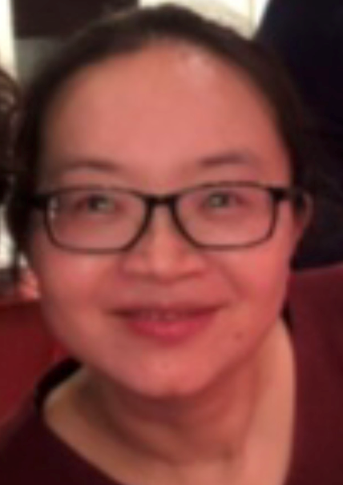
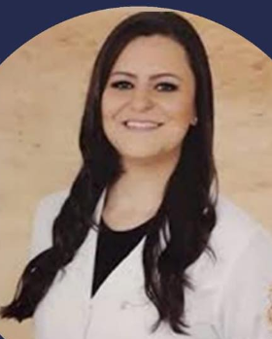
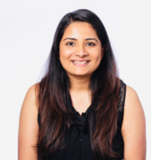
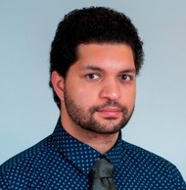
MMFP Clinician Team https://www.chop.edu/centers-programs/mitochondrial-disease-clinical-center/our-team
MMFP Primary Mitochondrial Clinicians
Joined Faculty August 2021
Matthew Demczko, MD
Cassandra Pantano, CRNP
MMFP Clinical Fellows & Observers
Isabella Peixoto de Barcelos, MD
NAMDC Fellow 2018-2019
Edward C. Shadiack III, DO
2019-2020
Sonal Sharma, MD
2020-2021
Ibrahim (Ibby) Elsharkawi, MD
2021-2022
Yi Guo, MD, PhD
Observer from China
2018-2019

Slide 12
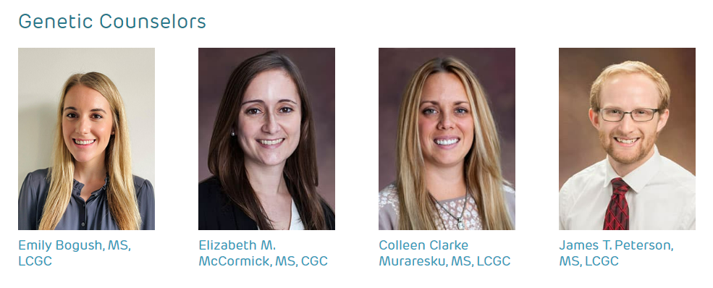
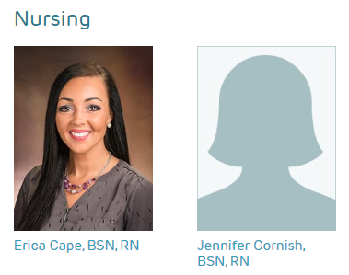
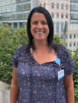
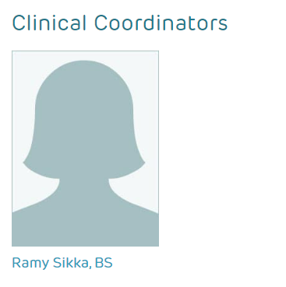
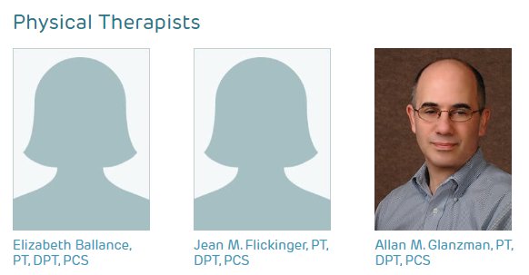
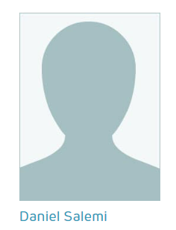
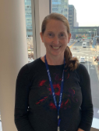
MMFP Clinical Staff
mmfp@chop.edu
267-426-4961
New Team Members!
Practice Manager- Aja Washington
Social Worker – Addie Fishstein

